Slide 1
RM Lunch and Learn
Inflation markets
4 April 2019
Notes:
15:50
TS: Two potential thoughts from me – one on liquidity (if you weren’t covering already) and anything on common most common strategies + indicators of when to trade would be interesting
What inflation index are they generally linked to?
What is market liquidity like (on the run / off the run)? Different countries?
Who buys in different markets / maturities?
What is the size of the market? Is it bigger / smaller than it used to be?
How does this market affect forward inflation breakevens?
What is the market reaction to stress?
Are there many derivatives traded based on this market (options / futures esp.)? Similar questions to above about liquidity etc.
A bit on the market structure.
What are the current main market discussions / flavours de jour etc?
What’s your favourite fact about inflation markets?
Who trades linkers/ inflation swaps
How/why do people trade inflation swap spreads
Liquidity at different parts of the curve
Nominal swap spread trades vs inflation swap spread trades- what does the different risk premia represent (nick C mentioned they look at trades like this)
Basic stuff probably also useful (I am sure there is lots I don’t know that is super simple!)
Other interesting trading things (you mentioned inflation spreads as an example!)
I’d be interested in relevance for the EEA (why/if they would be a good asset for us)

Slide 2
Outline
Background and market structure
Inflation-linked products
Trading aspects
Liquidity, trading strategies, pricing technicalities
Factors
Key drivers, impact of market stress
Why do we care, key market players, market size
Linkers, breakevens, swaps, options, ASWs
Product features, including inflation indices

Slide 3
Background
Why do we care?
Instruments used to take a read on inflation expectations
But pricing and trading idiosyncrasies can have important implications for observed market moves
Instruments used to lock a real rate of return
Sizable portion of government bond markets
Especially in the UK (~25%)
Relevance for the EEA
Portfolio diversification benefits and returns
RV opportunities

Slide 4
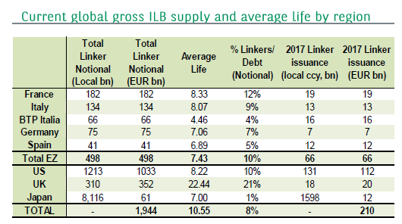
Global inflation bond markets
Notes:
All G7 nations currently issue inflation-linked bonds
To enhance monetary policy where there is a commitment to inf targetting]
To lower issuance costs
To provide a degree of investor diversification/ respond to investor demand
UK is the oldest and in % of debt terms largest IL market – first linker issued in 1981.
The stock of US TIPS (Treasury Inflation Protected Sec) is the largest in absolute terms (issued since 1997)
Methods of issuance
UK – auctions and syndications for new and existing bonds
All European issuers tend to tap existing bonds via auctions and would only syndicate new issues
Auctions only in the US (2 new 10yr TIPS per year, one new 5yr, one new 30yr + 2 re-openings for each issue)

Slide 5
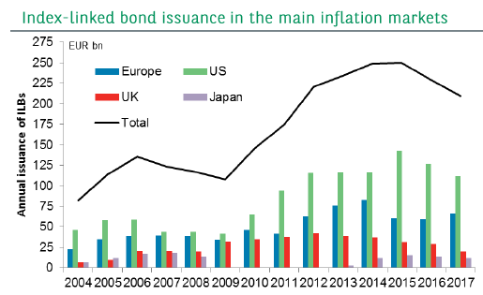
Global inflation bond markets
The main inflation-linked bond markets have been growing in size over the past 10 years, with the US the fastest-growing market
Notes:
Although the pace of Euro area linker issuance has been slow in Q1 2019 relative to previous years

Slide 6
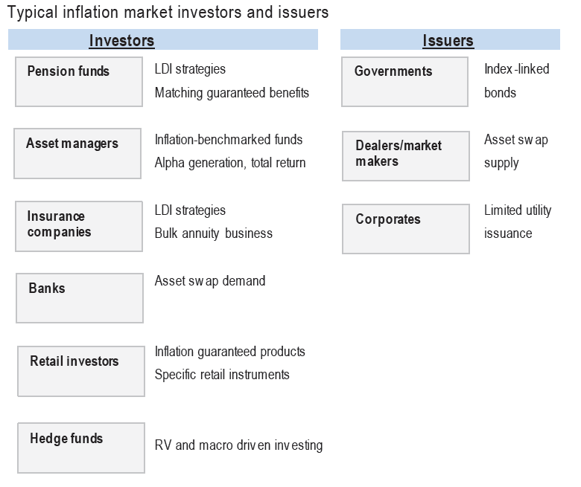

Key market participants
Typically there is a demand-supply imbalance
Notes:
Key buyers and sellers
Maturity split – long-end dominated by PFs, sub-10-year – Bank Tsys/AMs, HFs more active at the very short end
Market-specifics →
UK LDI demand
Dutch pension funds (although funding ratios for Dutch PFs is currently too low to allow indexation of benefits, hence demand is limited)
Livret A savings accounts in France include inflation component in the rate paid (creating inflation hedging demand)

Slide 7
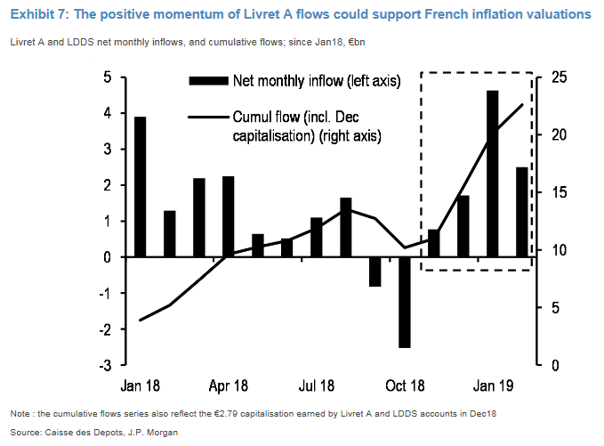
Livret A flows

Slide 8
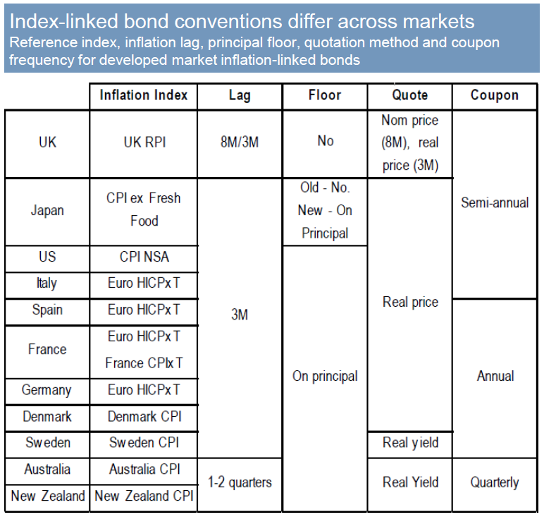
Conventions differ across index-linked instruments
Non-seasonally adjusted inflation indices!
Most have principals floored at 100 (even if inflation was negative over the period)
Notes:
Different inflation indices, sometimes even multiples
Lags
Deflation floor

Slide 9
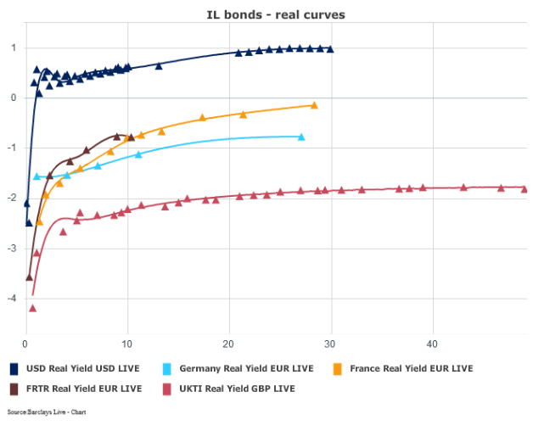
International real yield curves

Slide 10
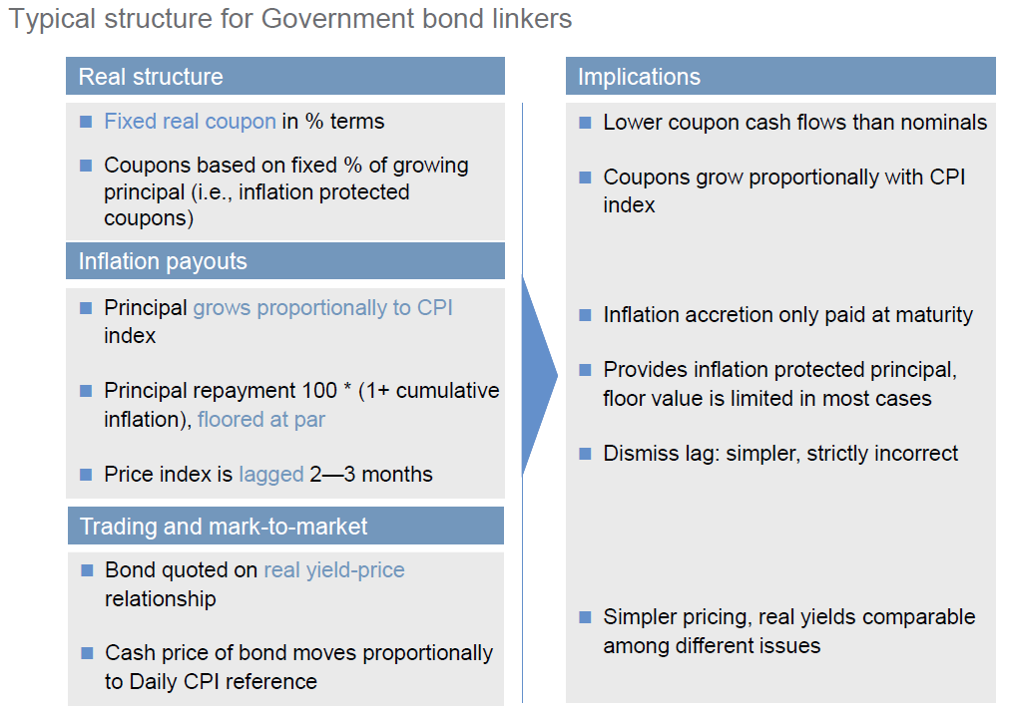
Inflation-linked bonds
Notes:
Index-linked bonds = inflation-linked bonds = linkers
Index-linked gilts in the UK and Treasury Inflation Protected Securities (TIPS) in the US
An index-linked bond has its cash-flows linked to a specific price index and provides investors with a way to lock in the real return. The bond will pay a fixed real coupon in % terms and a nominal principal value which will be increasing with inflation.
Most will also have a deflation floor which means the principal is guaranteed at maturity even if inflation is negative over the life of the linker. UK linkers are one of the exceptions and they don’t have this deflation floor and they trade above par.

Slide 11
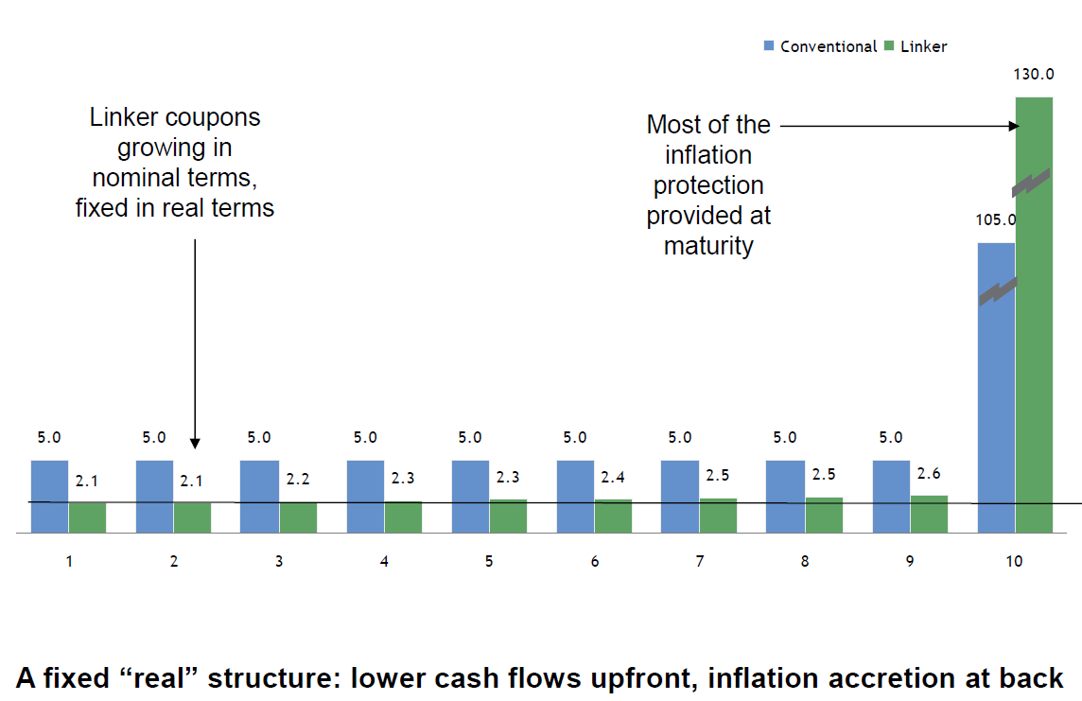

Ex-post cash flows – Linkers vs. conventionals
Due to the back-ended nature of linker cashflows, linkers have higher credit risk even for the same issuer
Notes:
The inflation protection is accumulating and increasing the principal, which is paid at the end. This means that the real coupon payments also increase slowly, but most of the inflation protection is provided at maturity. So this means that payments have this back-ended nature, and so linkers have by design have higher duration and credit risk profile.

Slide 12
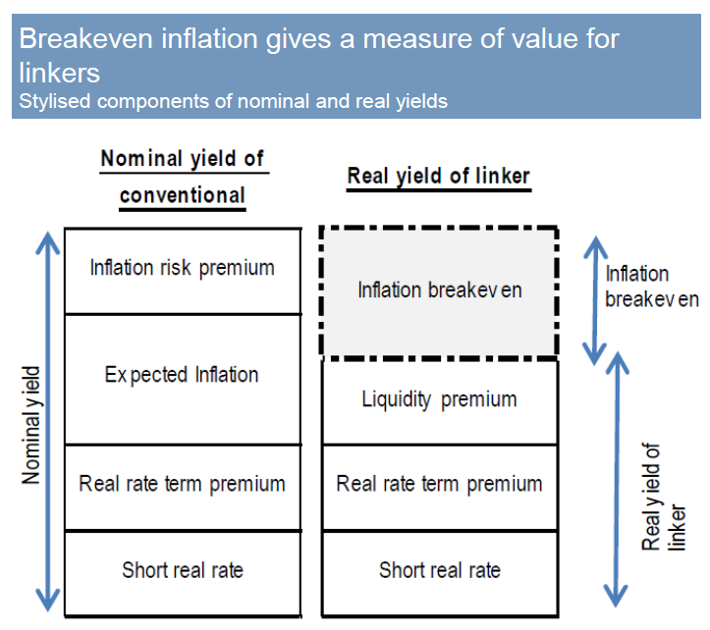
Breakeven inflation trades
The breakeven inflation level is the difference between the quoted real yield of a linker and the quoted nominal yield of a conventional bond with similar maturity
Rate of inflation that, if realised, will make me indifferent to holding linkers or conventionals
Breakeven inflation is better defined as a “preference spread”
From Fisher equation:
Nominal ≈ Real + Inflation
But breakeven ≠ expected inflation rate
Notes:
There will be a level of inflation which when realised, will make me indifferent between holding an inflation-linked bond or a nominal equivalent. We can decompose nominal and real yields as shown in this chart and the difference between these two quoted yields will be the inflation breakeven measure. But it is crucial to see that this will not equal to the expected inflation component from the nominal yield. Instead, the breakeven will be impacted by the inflation risk premium and liquidity premium.
Another way to look at this mathematically is using the Fisher equation, which boils down to nominal rate being approximately equal the real rate plus the inflation rate.
So when we typically talk about breakevens, we mean the difference between nominal and real yields on two bonds with similar maturity.
Purchasing a linker outright secures your real rate of return, but if an investor wishes to have exposure just to this inflation component, they can enter into a breakeven trade. This means they can trade an index-linked bond vs the conventional bond, e.g. buy the linker and sell the conventional.

Slide 13
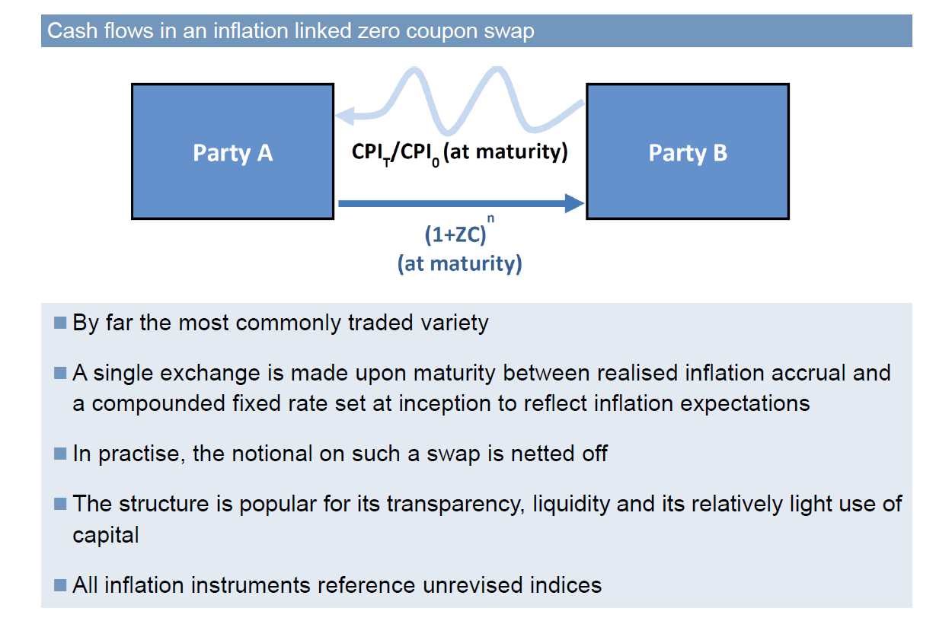
Inflation swaps – Zero coupon swaps
Notes:
The most active inflation swap markets are in the UK, the Eruo area (trading Euro HICP or French CPI) and US (trading US CPI)
Zero coupon inflation swap structures are by far the most common
Just like linkers, they trade with a lag
Liquidity
Trading linked to the undelrying linker market (up to 50 years in the UK, up to 30 years in other markets + market for short-term fixings too)

Slide 14

Forward inflation swap trades
Theory
Practice
Synthetic forwards
For a 5y5y inflation swap trade, we would want to take a view on the ratio of inflation in 5 years’ time to inflation in 10 years’ time
Autocorrelation and mean reversion in inflation series
Starting base index for forward-starting structures is uncertain
Traders typically construct synthetic forward inflation swaps from 2 spot swap rates
5y5y inflation swaps are commonly traded as 2*10y – 5y
Forward breakevens are additionally disadvantaged by the maturity gaps in the universe of available linkers.
Notes:
While 5y5y inflation swaps occasionally trade as a single swap, most investors opt to trade as a combination of two swaps. For a 5y5y swap, this is constructed as a double long position in the 10y swap vs a short position in the 5y swap.
If we wish to construct forward measures based on bond breakevens, we are additionally disadvantaged by the fact that linkers are only available for limited maturities and there are maturity gaps in the available universe. So with swaps, even though the forward wasn’t a true forward, at least it reflects 5y and 10y swaps, but with linkers, we use a constructed curve which may not actually have tradable 5y and 10y bonds at all times.

Slide 15
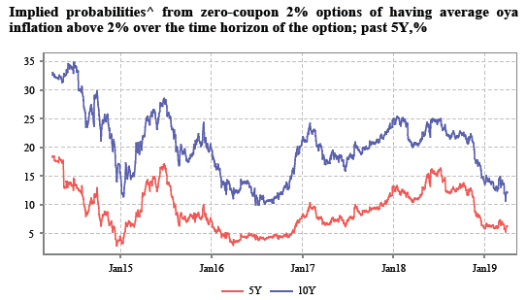
Other derivatives
No inflation futures
Options
Very specialist and not frequently traded
Illiquidity premium and structural demand factors (LPI)
Notes:
No futures – no demand/ complexity?

Slide 16
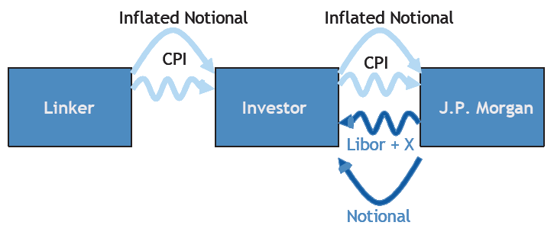
Linker asset swaps
Investor buys a linker, but agrees to pay away all the cash flows in exchange for Libor + X% until maturity
Notes:
There are more sophisticated instruments and trading structures, such as linker asset swaps. These are important because they feed into relative value metrics, which are used by investors to pick their positions, just like in any other market.
The buyer of the inflation asset swap purchases an inflation linked bond (at par or DP), exchanges the inflation linked payments for Libor-based CFs, and receives a final payment at maturity.
Asset swaps can effectively isolate the credit component and liquidity component of the IL bond, and also strip out duration risk. This allows a more complete possibility of RV trades in inflation
They offer a pick up over Libor relative to nominla ASW – bank Tsy demand (due to higher credit risk/higher duration of linkers).

Slide 17
Relevance for the EEA
Increased returns
Linker ASW returns
Diversification
But higher liquidation costs and volatility
Increased RV opportunity set
Pure RV, curve trades, breakeven trades, ASW spreads, cross-market, auction strategies
MI benefits

Slide 18
Liquidity
Linkers
Less liquid than nominal bonds
TIPS daily trading volume with primary dealers averaged just $16bn/day in 2016 compared to about $511bn/day for USTs
Swaps
5y, 10y, and 30y the most liquid + 5y5y + short term fixings
US swaps are significantly less liquid than TIPS
Trading volumes in 2016 averaged just $9bn/month
Better liquidity in the long-end → preferred habitats

Slide 19
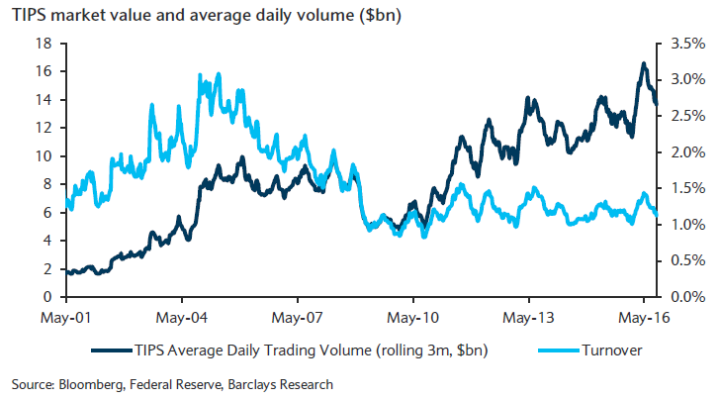
TIPS market value and average daily volume
Notes:
Daily volumes have been increasing but keeping pace with increased issuance so turnover has been stable
Shift towards buy and hold investors as issuance increased

Slide 20
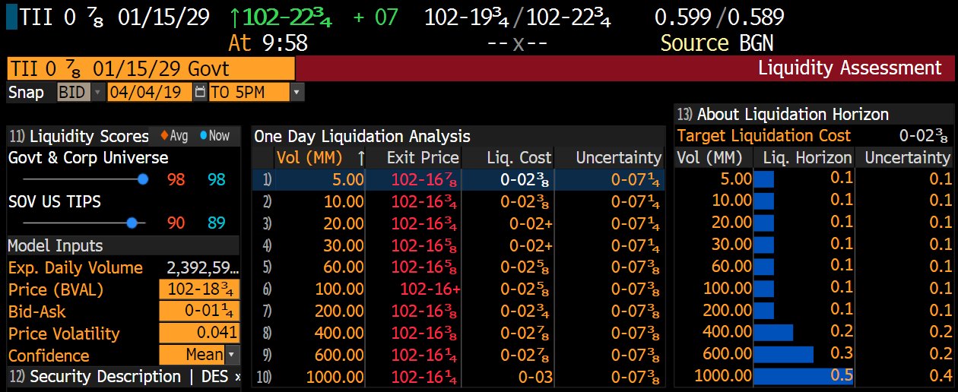
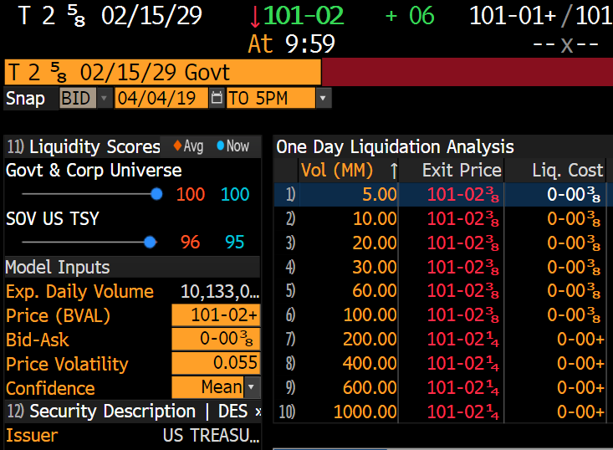
Liquidation costs

Slide 21
Additional trading considerations
Seasonality
Carry
Income accrued while holding a security minus the funding cost
But linkers have a real carry component and an inflation component → more volatile carry
Holding a linker for a given period gives you positive carry effect during periods when (lagged) inflation indices increase
Investors happier to buy in carry +ve months but market not always efficiently priced
Monthly rolls on swaps

Slide 22
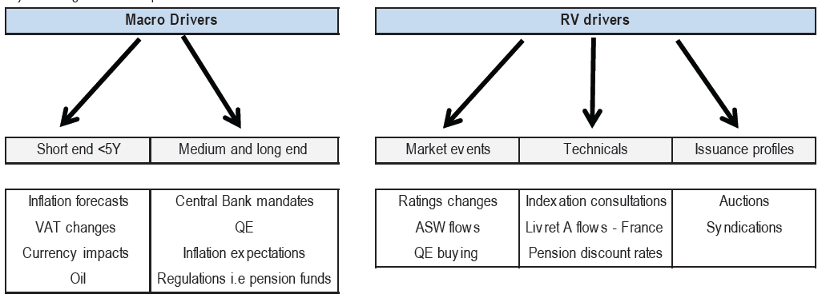
Macro and RV drivers of inflation market valuations
Notes:
Actual inflation outturns, including base effects
QE → impact of CB purchases or expectations for purchases (UK – nominals only)
Ratings changes → higher credit risk/duration of linkers means they are more affected
Structural demand → pension funds (including any changes to regulations), livret A, index funds (index extension rebalancing flows)
Any changes to the inflation indices – RPI debate/ German package holidays, weights and re-basing

Slide 23
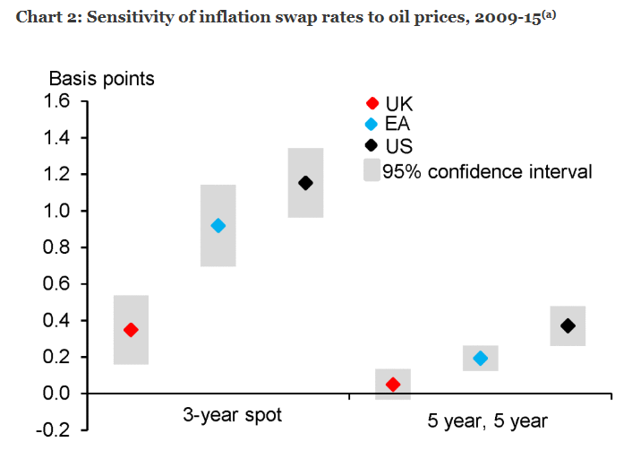
Impact of energy prices
Bank Underground post

Slide 24
Market stress – Risk aversion and liquidity premia
Index-linked bonds tend to underperform conventional bonds at times of market stress, due to their relative illiquidity
Market stress drives liquidity premium up, pushing down on prices of index-linked bonds, putting downward pressure on breakevens
Dealers may also be less willing to take risk onto their balance sheets
10-year spot breakeven inflation and VIX index

Slide 25
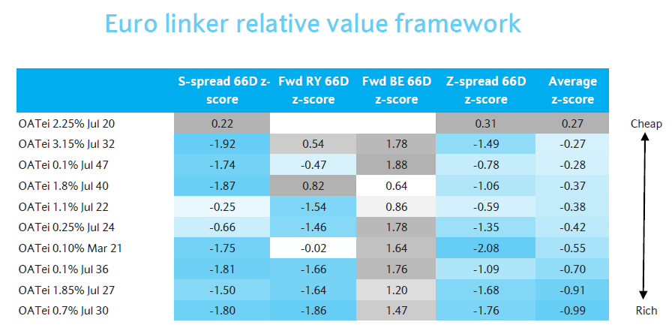
Notes:
An IL bond exposes an investor to a variety of financial risks, such as rate risk, inflation risk (including seasonality), credit risk, TP, and liquidity risk
In order to determine RV between different IL bonds, we need to strip out as many of these risks as possible
Can compare linkers to swaps (ASW) but this still includes credit risk
Can look at iota ASW – linker ASW minus nominal ASW (to strip out credit risk)

Slide 26
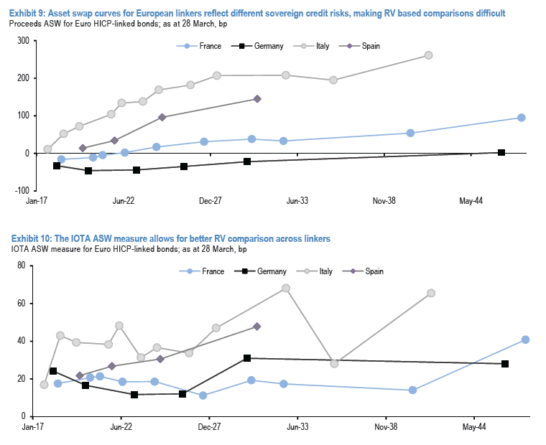
ASW measures

Slide 27

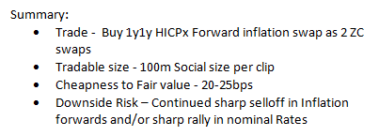
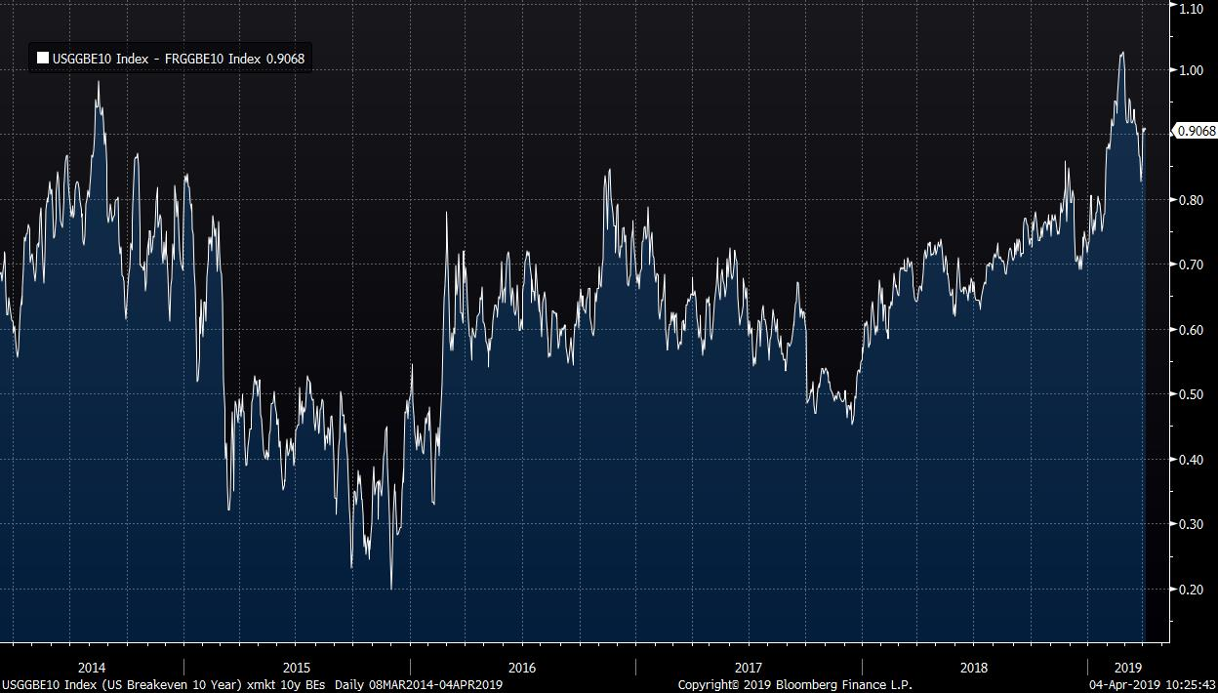
Trade ideas

Slide 28
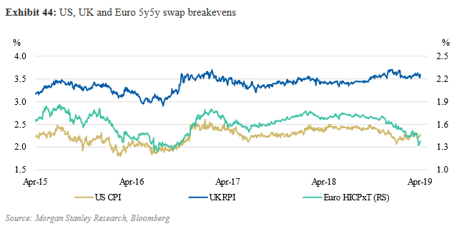
Latest themes
Notes:
Low euro area inflation valuations
RPI consultation in the UK and Brexit impact (credibility?)
Carry turning positive in April

Slide 29

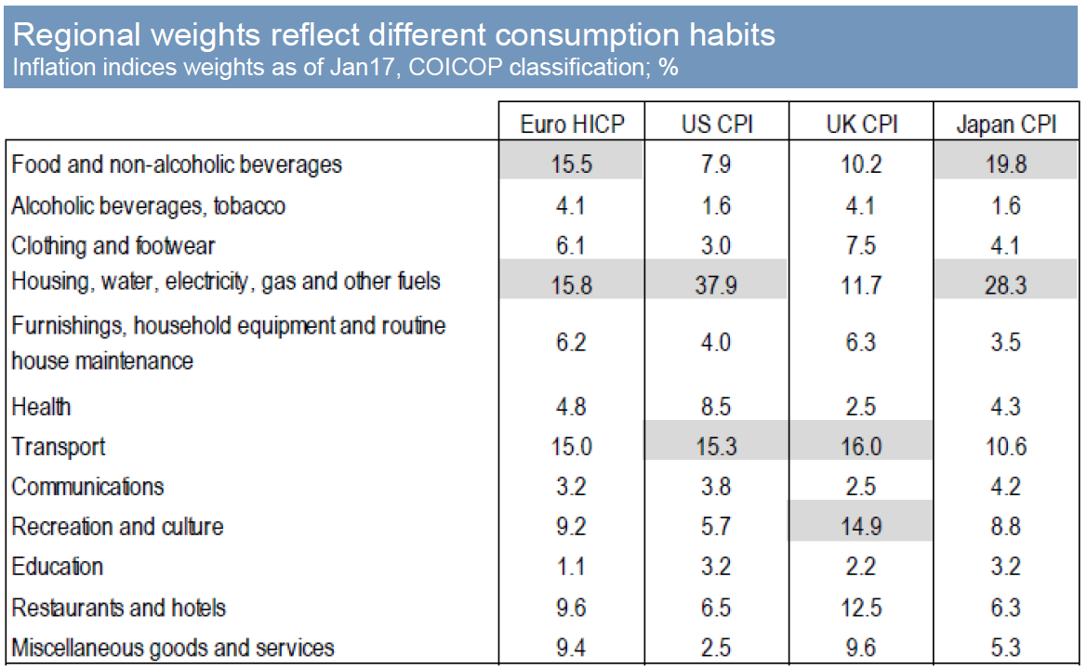
Key concept 1: Inflation indices
Energy prices form a significant part of the US index
Not all inflation is the same and not all instruments link to the same kind of inflation
Notes:
Inflation linked instruments have their cashflows linked to some inflation index, but what that specific index is will matter for two reasons.
1. Inflation-linked instruments in different markets will reference different kind of inflation indices (i.e. based on different baskets of goods). For example, most instruments in the UK are linked to RPI, whereas TIPS in the US are linked to CPI. This matters because RPI includes housing and mortgage interest payments, so for example changes in Bank Rate might feed through to higher RPI via higher mortgage interest payments.
2. Even if we were to take the same basket of goods, the weighs used to calculate the indices in different markets reflect different consumption habits. For example, this table shows the weights within CPI in different countries, and you can see that energy prices are important in the US CPI calculation. This is why we find that moves in US inflation compensation measures are more correlated with moves in oil and gasoline prices.

Slide 30
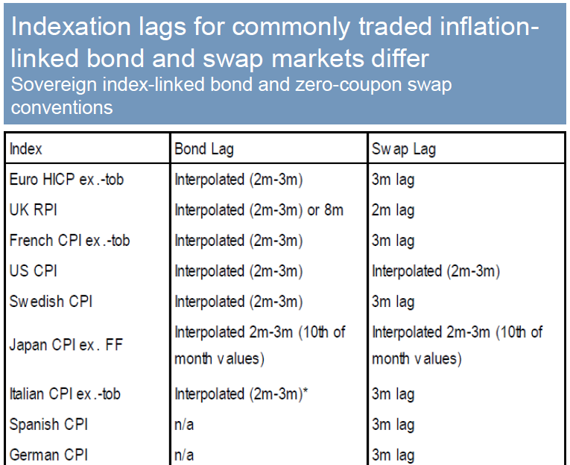
Key concept 2: Inflation lags
All inflation-linked instruments trade with a lag because it takes time to collect and publish inflation data
Lag conventions vary across markets and instruments

Slide 31
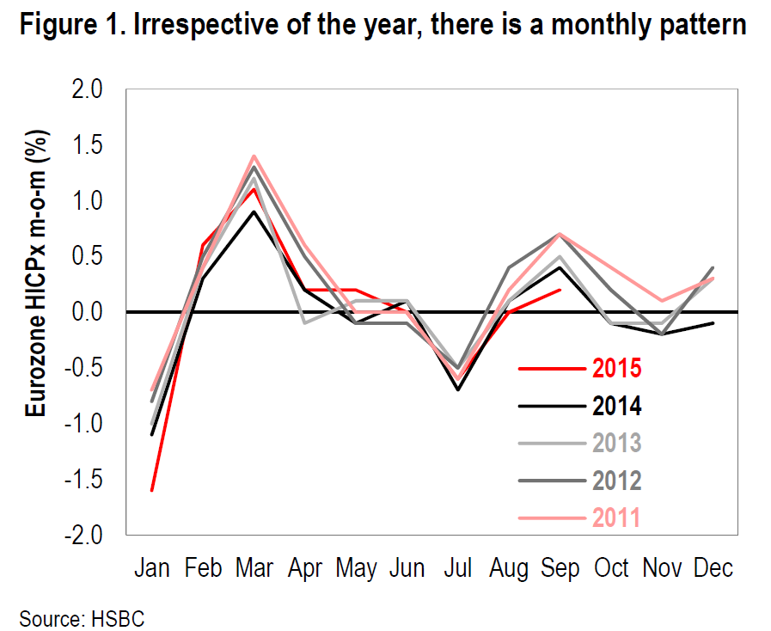
Key concept 3: Seasonality
Inflation as a time series is highly seasonal
Year-on-year inflation neutralises this seasonality
But inflation protection on inflation instruments will be calculated from non-seasonally adjusted indices
Seasonal trends are predictable so an efficient market prices this in but there is always some uncertainty
Valuations will be affected with a lag
Notes:
Inflation as a time series is highly seasonal throughout the year. Standard inflation measure is a year-on-year metric so it neutralises this seasonality. But the inflation protection on inflation instruments will be calculated from non-seasonally adjusted indices.
Because these seasonal trends are to some extent predictable, an efficient market should price this in. But there is always some uncertainty and seasonality can turn out to be surprisingly strong or weaker-than-expected.
This means that market valuations will be affected, but going back to the previous key concept, valuations will be affected with a lag.
So it is important to be aware which month is being referenced by a market instrument and what’s happened to the seasonal component within inflation prints.

Slide 32
Pricing 3-month linkers: Back to bond basics
What do we need to price a bond?
Calculate the present value of future coupon payments
But future inflation is unknown, so future cash flows are unknown
The Canadian model for index-linked bonds circumvents this issue. This model is globally accepted as the standard framework
Key advantage: Bonds trade in real price terms so there is no need to make any assumptions about future inflation
But when a linker is bought, the unadjusted quoted price has to be adjusted for accrued inflation to determine effective price paid
Notes:
As with any bond, what we need is to calculate the present value of future cash flows from this bond.
Problem: Cash flows will be linked to future inflation so they are unknown in nominal terms. Most global linkers trade based on the so called Canadian model, which circumvents this problem.
Key point is that this model allows us to calculate everything in real price terms and for this there is no need to make any assumptions about future inflation. So key to note is that linkers trade in real price terms.
When the linker is bought, this unadjusted quoted (real) price has to be adjusted for how much inflation has been accrued over the life of the linker in order to work out the effective price that needs to be paid.

Slide 33

Pricing 3-month linkers: Practical considerations
In practice, there are two notable aspects:
Inflation lags – indexation is based on inflation data 3 months prior
Daily reference values of the inflation index need to be computed so that principal can be adjusted for every trading day
Implications:
Daily Inflation Reference (using linear interpolation between lagged inflation):
for any day d in the month m
The Index Ratio (measures the total inflation since accretion):
Notes:
To calculate this effective price, there are two things to bear in mind.
1. Lags - for these standard 3-month lag linkers, indexation and all pricing calculations will be based on inflation 3 months prior. For example, if we want to price a bond today (7 Sep), we would need to look at the price indices from June.
2. Today is not the first day of the month, in fact we are 7 days closer to using the July index instead of June. In practice, this means that we need to interpolate between fixings 2 and 3 months prior to payment.
Two main formulae.
Daily Inflation Reference to calculate the linear interpolation between lagged inflation for any day of settlement.
The Index Ratio is the ratio of this daily reference today against a base, which is the point from which we started accruing inflation. Normally this is the daily inflation reference that was calculated when the bond was issued.

Slide 34
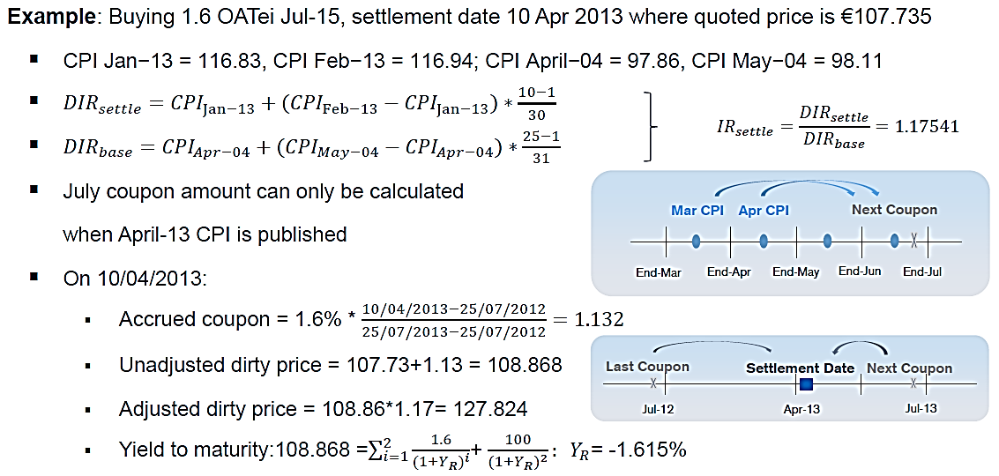
Practical example
Remember: Inflation protection is only paid when the bond matures. When buying the bond in 2013 we need to pay for all the accrued inflation since 2004.
Notes:
Assume today is 10 April 2013 and we are purchasing a French linker with the quoted price of 107 euros.
The two lagged price indices that we need are from Jan and Feb (2 and 3 months before April). We also need the April and May 2004 prints, because the linker was issued on 25 July 2004 and given the usual lags, it would have actually started accumulating inflation from April 2004.
We use these to calculate our two daily inflation references. First calculation takes into account the fact that we are 10 days into April and so we interpolate between the Jan and Feb 2013 prints accordingly.
For our base, we look at April and May 2004 prints. This gives us today’s index ratio as the ratio of these two. So this is how much inflation protection the linker has accrued since issuance. Just as a reminder, linkers only pay the inflation protection right at the end at maturity, so this inflation would have been accumulating but is yet to be paid out.
We also need similar calculations to calculate how much accrued coupon we have and we add it to the quoted price to calculate our unadjusted dirty price. We then multiply by the index ratio to work out the adjusted dirty price, which is what needs to be paid.

Slide 35
UK special case: 8-month “old-style” linkers
No longer issued, but four linkers still continue to trade
Coupon payments based on inflation 8-months prior
Different pricing formula:
Real yield calculation is more complex because “old style” linkers trade in nominal price terms (i.e. not unadjusted for inflation).
Each time an RPI print is released, it replaces one month of a 3% inflation assumption with the actual value.
The real yield will mechanically adjust depending on the degree to which the m/m realised inflation print differs from the 3% annual assumed inflation.
Notes:
UK has some special 8-month linkers, which reference inflation 8 months prior. But they follow a different pricing formula, instead of the Canadian model. Instead, they trade in nominal price terms, so not unadjusted for inflation. This makes the real yield calculation a bit more complex and it means that you need to make an assumption about future inflation. The convention is to assume RPI inflation of 3% and replace this assumption with the actual print once the print is released.
As a result, if the inflation print differs from this assumption, the real yield will mechanically adjust. This is important because we can observe some chunky moves when inflation data is released and if these linkers are feeding into calculations of fitted curves, they can distort these curves.

Slide 36
Bond positions vs derivative positions
Possible trades:
 | Cash | Derivative
Exposure to real rates (and inflation) | Buy/Sell the inflation-linked bond | Real rate swap
Exposure to inflation | Buy (sell) the IL bond vs Sell (buy) the nominal bond (Breakeven trade) | Inflation swap
 | Asset swaps, Total Return Swaps, Options

Slide 37
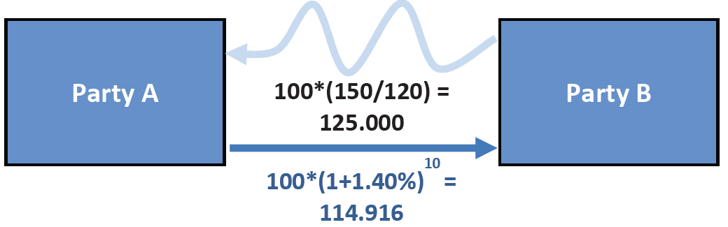
Practical Example – 10y zero coupon inflation swap
Current 10Y Euro HICP swap rate = 1.40%
Party A thinks that annual HICP inflation will average more than 1.40% over the next 10 years → Party A buys €100mn of the zero coupon swap
Current index level = 120
Index level in 10 years’ time = 150
Total accrued inflation = (150/120 = 1.25)

Slide 38




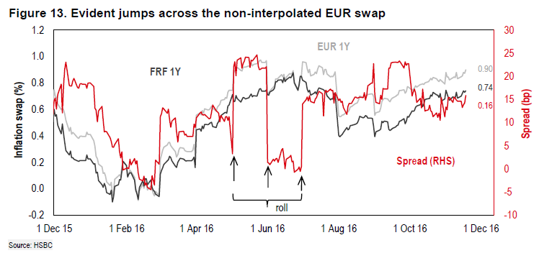
Interpolation and inflation swap curves “roll”
Non-interpolated | Interpolated
We care about settlement month | Precise settlement date matter
Two types of lags:
Example index ratio: CPI (Aug’22) / CPI (Aug’17)
Counterintuitive monthly index “roll”
Low inflation prints will make inflation swaps jump higher because the index ratio increases
Notes:
Just like index-linked bonds, zero coupon swaps are subject to lags, but there are two different variations.
In US and French swaps follow something similar to what we had in the Canadian model for linkers (i.e. daily linear interpolation between price indices 2 and 3 months earlier). So we care about the specific date of settlement, e.g. 7 July 2017 and 7 July 2022. [Note: These make it harder to net off positions]
In contrast, sterling and euro swaps use non-interpolated lags, which means that the day of the trade doesn’t matter in any given month because we only care about the settlement month.
Example: Sterling swaps use 2-month lags, so if we enter into a swap today or on any day this month, we will be referencing July inflation, e.g. for a 5y swap, our payment will depend on the ratio between July 2017 inflation and July 2022 inflation.
The implication for this is that non-interpolated swaps can exhibit a jump on the first day of every month when the index month changes. So in September, our 5y swaps traded July inflations, but from the 1st October, they will trade August inflation. If the August 2017 inflation surprised significantly to the downside, the denominator in the index ratio will be lower, increasing the index ratio will increase, which means that the inflation swap rate will mechanically adjust higher. [Counterintuitive from this perspective – low inflation print pushes up on swap rates]

Slide 39
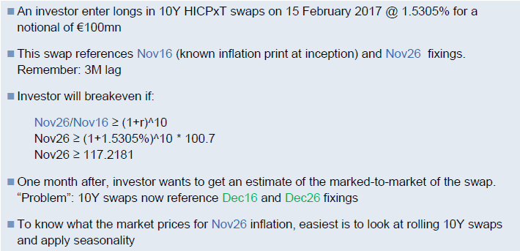
Example - Marking to market a zero coupon swap

Slide 40
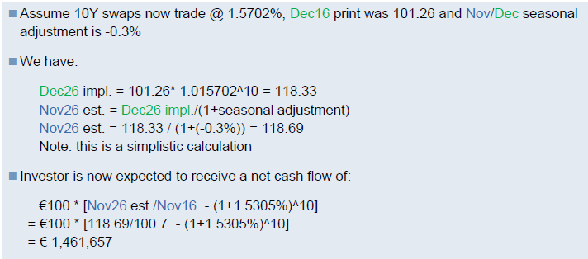

Example - Marking to market a zero coupon swap
Estimate of Nov26 inflation has increased so the position is in-the-money

Slide 41
Relative value metrics
Inflation swaps
IOTA breakeven
(traded)
Z-spread
(not traded)
ASW IOTA measure
Nominals
Linkers
ASW measure
Different metrics available to find value in inflation-linked instruments.
Inflation swaps and inflation-linked bonds price inflation differently. Therefore, these measures are more helpful in assessing relative value between inflation swaps and bond breakevens, than just simply looking at outright market prices.

Slide 42
Asset swap spreads, IOTAs and Z-spreads
Starting point for these measures:
Pricing of linker asset swap transactions
ASW spread
- Comparison of ASW levels of various linkers (as a spread over LIBOR)
- But cross-market comparisons are difficult because of issuer credit risk
IOTA ASW spread
- Difference between ASW levels of inflation-linked bonds and their comparator conventional bonds
- This measure removes some of the credit risk component from ASW spread measure. It captures liquidity premium, duration and inflation expectations
- The higher the IOTA ASW then the cheaper the linker is relative to the nominal bond
Z-spread
- Purely theoretical:
- The parallel shift in the LIBOR curve required to equate the present value of the projected inflation-linked cash flows, where inflation swap curve is used to project future cash flow, to the bond’s dirty price.
- Better indicator of true RV than ASW, as it includes term structure and removes distortions (seasonality, inflation accrual etc.). But not tradable.
- IOTA Z-spread is then defined as the z-spread on the linker minus the Z-spread on the nominal comparator
r
IOTA breakeven
- Relative value of inflation swaps vs. breakevens
- The higher the IOTA breakeven, the richer inflation swaps trade relative to cash breakevens
Equivalent
(See next slide)
Notes:
Starting point: Pricing of linker asset swaps, i.e. if we were to purchase a linker and exchange the inflation linked payments for Libor-based cash flows, what would be the spread over Libor that we would receive? (Slide 22 diagram)

Slide 43
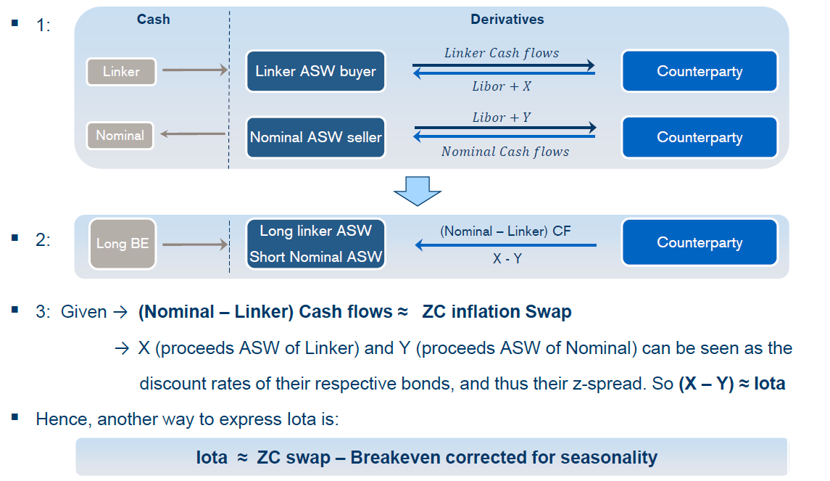
Z-spread and IOTA Spread in more depth
Being long IOTA is equivalent to being long Linker ASW and short Nominal ASW

Slide 44

Inflation market jargon
Inflation swaps
Richening = swap rate increasing
Cheapening = swap rates falling
Linkers
Richening = real rates falling
Cheapening = real rates rising
Valuations
Positions
B/Es
Short:
Buy nominal
Sell linker
Pay inflation
Short:
Pay inflation
Pay floating
Receive fixed
Inflation swaps
Long:
Receive inflation
Receive floating
Pay fixed
Long:
Buy linker
Sell nominal
Receive inflation
Richening and cheapening implies moves in different directions depending on instrument
B/Es
Richening = B/Es increasing
Cheapening = B/Es falling
Paying/receiving refers to the inflation (floating) leg. This is opposite to standard IRS

Slide 45
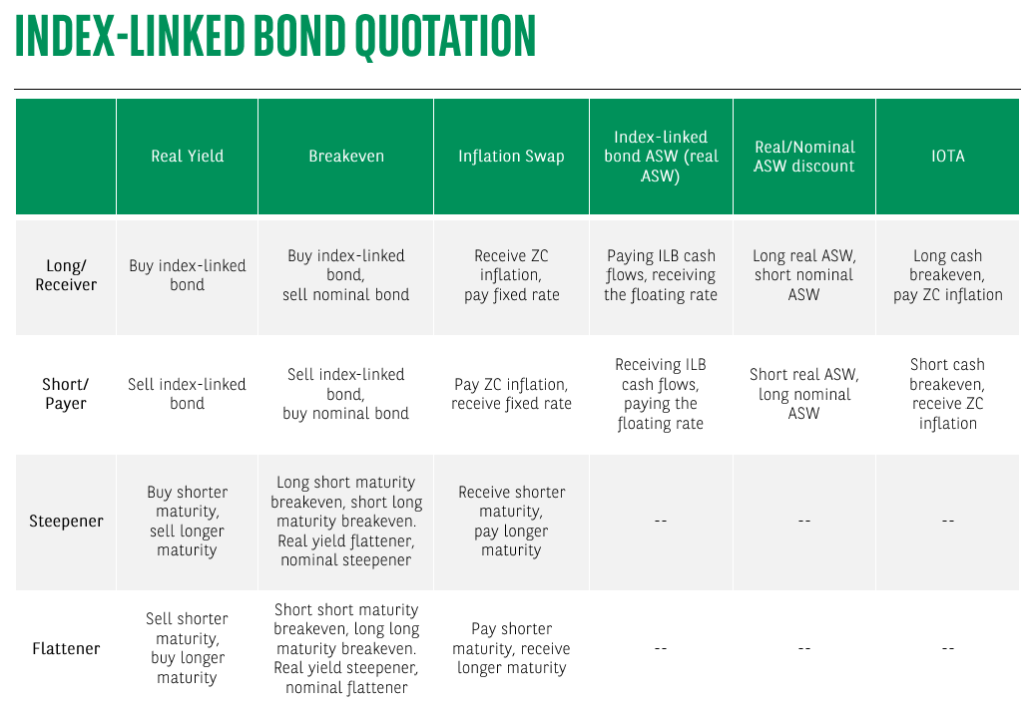

Slide 46

Implications for market monitoring
CPI vs RPI
Swap roll
Monthly index roll leads to jumps in short-dated swap rates
8-month linkers
Spot rates
Interpretation of spot zero coupon swap rates
Inflation data releases lead to a mechanical re-pricing of 8m linkers when there are large data surprises
UK measures are linked to RPI so market reaction to inflation data releases depends on RPI print
Graphic credit: Iain Ramsay

Slide 47

Any final questions?

